Slide 1

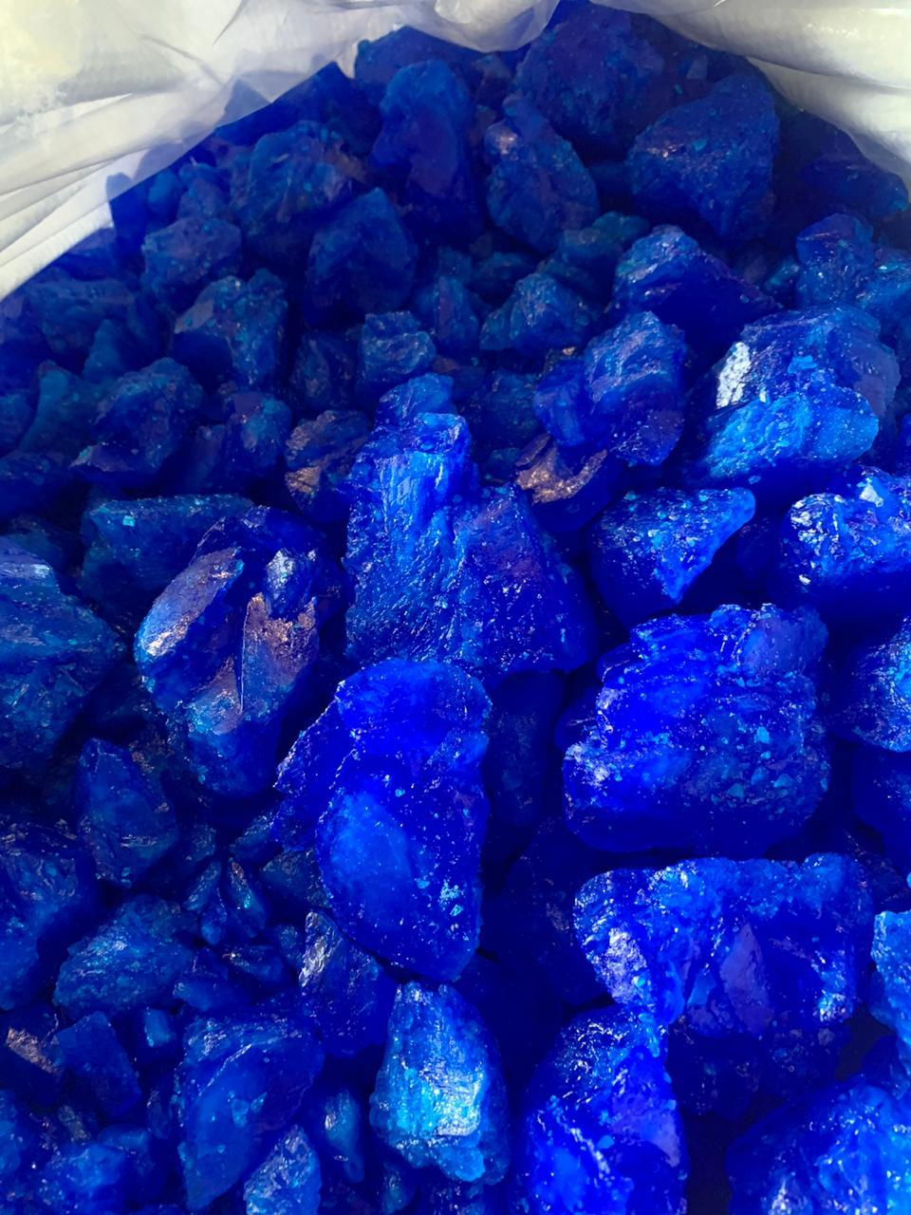

2016 – 2026
SOUTH-EAST ASIA COPPER SULPHATE MARKET
BY GRADE, BY END USE,
BY TYPE, BY COUNTRY,
COMPETITION, FORECAST & OPPORTUNITIES
MARKET INTELLIGENCE . CONSULTING
www.ChemAnalyst.com

Slide 2
Table of Contents
S. No. | Contents
1. | Copper Sulphate: An Introduction & Product Classification
2. | Research Methodology
3. | Executive Summary
4. | Voice of Customer/End User Analysis
 | 4.1. | Major Influencing Factor affecting Vendor Selection
 | 4.2. | Challenges Faced (Need-Gap Analysis)
 | 4.3. | Satisfaction Level of Product Pricing (N=50)
5. | South-East Asia Copper Sulphate Market Outlook
 | 5.1. | Market Size & Forecast
 |  | 5.1.1. | By Value & Volume
 | 5.2. | Market Share & Forecast
 |  | 5.2.1. | By Type (Hydrous, Anhydrous)
 |  | 5.2.2. | By Grade (Industrial Grade, Reagent Grade)
 |  | 5.2.2. | By End Use (Agriculture, Animal Husbandry, Healthcare, Industrial , Chemicals, Leather and Textiles & Others)
 |  | 5.2.4. | By Country (Indonesia, Malaysia, Philippines; Vietnam; Thailand; and Rest of Southeast Asia)
 |  | 5.2.5. | By Company (2020)
 | 5.3. | Market Mapping
6. | Indonesia Copper Sulphate Market Outlook
 | 6.1. | Market Size & Forecast
 |  | 6.1.1. | By Value & Volume
 | 6.2. | Market Share & Forecast
 |  | 6.2.1. | By Grade
 |  | 6.2.2. | By End Use
 | 6.3. | Copper Sulphate Trade Dynamics
 | 6.4. | Competition Outlook
7. | Thailand Copper Sulphate Market Outlook

Slide 3
Table of Contents
S. No. | Contents |  |  | Page No.
 | 7.1. | Market Size & Forecast (Demand Volume)
 |  | 7.1.1. | By Value & Volume
 | 7.2. | Market Share & Forecast
 |  | 7.2.1. | By Grade
 |  | 7.2.2. | By End Use
 | 7.3. | Copper Sulphate Trade Dynamics
 | 7.4. | Competition Outlook
8. | Malaysia Copper Sulphate Market Outlook
 | 8.1. | Market Size & Forecast
 |  | 8.1.1. | By Value & Volume
 | 8.2. | Market Share & Forecast
 |  | 8.2.1. | By Grade
 |  | 8.2.2. | By End Use
 | 8.3. | Copper Sulphate Trade Dynamics
 | 8.4. | Competition Outlook
9. | Vietnam Copper Sulphate Market Outlook
 | 9.1. | Market Size & Forecast (Demand Volume)
 |  | 9.1.1. | By Value & Volume
 | 9.2. | Market Share & Forecast
 |  | 9.2.1. | By Grade
 |  | 9.2.2. | By End Use
 | 9.3. | Copper Sulphate Trade Dynamics
 | 9.4. | Competition Outlook
10. | Philippines Copper Sulphate Market Outlook
 | 10.1. | Market Size & Forecast
 |  | 10.1.1. | By Value & Volume

Slide 4
Table of Contents
S. No. | Contents |  |  | Page No.
 | 11.2. | Market Share & Forecast
 |  | 10.1.1. | By Grade
 |  | 10.1.2. | By End Use
 | 10.3. | Copper Sulphate Import & Export Statistics
 | 10.4. | Competition Outlook
11. | Rest of South-East Asia Copper Sulphate Market Outlook
 | 11.1. | Market Size & Forecast
 |  | 11.2.1. | By Value & Volume
 | 11.2. | Copper Sulphate Trade Dynamics in Rest of Asia Region
12. | Market Dynamics
 | 12.1. | Impact Analysis
 | 12.2. | Drivers
 | 12.3. | Challenges/Restraints
13. | Market Trends & Developments
14. | Product Benchmarking (Supplier-wise grade)
 | 14.1. | By Supplier
 | 14.2. | By Grade
15. | Customer Analysis (Buyer Coordinates and Consumption Behavior of Top 25 companies in South-East Asia)
 | 15.1. | Plant Location
 | 15.2. | Grade Wise Monthly Consumption
 | 15.3. | Supplier Details
 | 15.4. | Key Contact Person – Person Name, Email Id, Designation
 | 15.5. | Incoterms
 | 15.6. | Packaging Details
16. | Competitive Landscape
 | 16.1. | Company Profiles (Leading 5 Companies)
17. | Strategic Recommendations
18. | About Us & Disclaimer

Slide 5
Table of Contents : Additional Customization
S. No. | Contents |  | Page No.
1. | Global Copper Sulphate Manufacturing Process Overview
 | 1.1. | Process Details
 | 1.2. | Technological Maturities
2. | Global Manufacturing Cost Analysis
 | 2.1. | Raw Material
 | 2.2. | Margin
 | 2.3. | Variable Cost
3. | Global Copper Sulphate Demand-Supply Outlook
4. | Country-Wise Import of Copper Sulphate in South-East Asia , By Value & Volume - 2020
 | 4.1. | By Country
 | 4.2. | By Grade

Slide 6
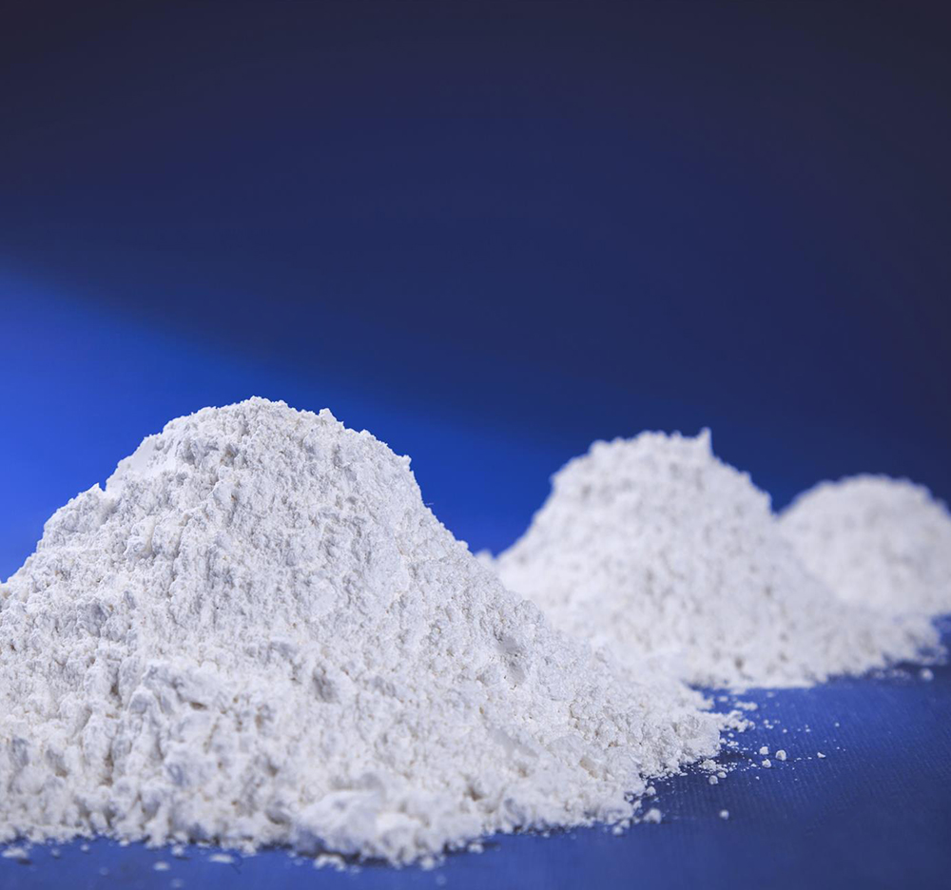
Scope of Report
Product of Interest (POI): Copper Sulphate
Copper sulphate or CuSO4 is an inorganic compound that combines copper and sulphate. In the liquid or powdered form, it is commonly called basic copper sulphate, tri–basic copper sulphate, or CP basic sulphate. In the solid form, a crystal shaped stone is formed which is commonly known as pentahydrate or blue stone or blue vitriol for its blue color. In the solid form, it is mostly used as a raw material for producing other copper salts. It is a multipurpose chemical with large number of uses in industries as well as in agriculture. Copper Sulphate has end use in major industries like agriculture and pharmaceutical industry. Besides, it also finds extensive applications in several other fields like coatings, adhesives & sealant industries, construction industry, chemical industry, and others. Due to its ideal properties, it is often used in the pharmaceutical industry as an anti-malaria agent, antiseptic and germicide against fungus infections.
Market Segmentation
TYPE
END USE
Hydrous
Anhydrous
Agriculture
Animal Husbandry
Healthcare
Industrial
Chemicals
Leather and Textiles
Others
Review Period
2016 – 2019
Base Year
2020
Estimated Year
2021
Forecast Period
2022 – 2026
Year Range
GRADE
Industrial Grade
Reagent Grade
COUNTRY
Indonesia
Vietnam
Malaysia
Philippines
Thailand

Slide 7

Research Methodology

Slide 8

Research Methodology
Market Profiling
Formulating Questionnaire
Developing List of Respondents
Data Collection
Data Validation
Data Analysis
In-depth secondary research was conducted to determine top players in South-East Asia Copper Sulphate market, overall market size and segmental market size.
In order to conduct industry experts’ interviews, ChemAnalyst formulated a detailed discussion guide.
List of industry players and industry specialists was developed.
ChemAnalyst conducted interviews with industry experts and industry players for data collection and verification.
Data obtained as a result of primary and secondary research was validated through rigorous triangulation.
The data was scrutinized using MS-Excel, statistical tools and internal proprietary database to obtain qualitative and quantitative insights
Primary Research
Desk Research
Company Analysis
Identifying Key Opinion Leaders
Questionnaire Design
In-depth Interviews
Recent Developments
Market Changing Aspects/Dynamics
Government Policies
Final Conclusion
Market Participants
Key Strengths
Primary Research
Secondary Research
Paid Sources
LinkedIn
ChemAnalyst Internal Database
Company Websites
Company Annual Reports
White Paper Study
Financial Reports
Investor Presentations
Regulatory Body
Associations, etc.
Factiva
Hoovers
Data
Collection
Data Filter
& Analysis
Research &
Intelligence
Actionable
Insights
Business
Solution

Slide 9

Research Methodology
Respondents were asked about the current and future market growth rates, as well as market shares by type, by end use, by grade, by country and by company. Removing the outlier responses, the geometric mean of growth estimates and provider wise revenue shares generated across various segments were considered, to arrive at the final revenue shares. Revenue shares generated across various segments were further triangulated from other stakeholders
Methodology Followed for Calculation of Market Shares:
Market shares by type, by end use, by grade, by country and by company were calculated based on the responses received through primary surveys with industry experts, in which the respondents were asked about the market shares of the leading Copper Sulphate supplier in South East Asia. The final shares were calculated by taking the geometric mean of the responses gathered from key opinion leaders after eliminating the outliers. Moreover, respondents were asked about the leading companies.
Methodology Followed for Forecasting:
ChemAnalyst performed periodical checks on data collected through the surveys with logical checks and analyzed the survey results in SPSS/Tableau Software.

Slide 10
Research Methodology
Data triangulation techniques were applied to fill the gaps and to present a more meaningful picture of the market. To forecast South-East Asia Copper Sulphate market, ChemAnalyst used various forecast techniques such as:
Moving Average
Time Series Analysis
Regression Analysis
Econometric and Judgmental Analysis
ChemAnalyst used its own forecast tool, which is based on the growth of various allied industries in respective regions. ChemAnalyst also used the impact analysis during short, medium- and long-term period to estimate and analyze market demand scenario.
Partial List of Secondary Sources | Metal Bulletin, CRU Group, UN Comtrade, World Bank, Industry Association, FaoStat
Partial List companies Interviewed | Chemtronic Technology (Thailand) Co Ltd, Pt. Lam Seng Hang Indonesia, Buildmore Enterprise Co., Ltd, Pt. Fajar Zippindo Pt, Allan Chemical Corp., ATOTECH, NOAH Technologies Corp., WEGO Chemical and Mineral Corp., Kirsch Pharma GmbH., JL Chemtonic Co., Ltd, Remix Resilient Mix Sdn. Bhd

Slide 11

South-East Asia Copper Sulphate Market Voice of Customer

Slide 12
Voice of Customer
Major Influencing Factors Affecting Vendor Selection (N=50), 2020
Source: ChemAnalyst
While conducting the consumer survey to derive the vendor selection, the consumers were asked to name factors which influence the vendor selection. On the basis of their responses it has been found that availability of product is a major factor which influences the customer for selecting the vendor followed by brand with 90%, price with 88%, lead time with 85% and discount with 80%.

Slide 13
Voice of Customer
Challenges Faced (Need-Gap Analysis), 2020
While conducting the consumer survey to derive the challenges faced by customers, it has been observed that the product quality is the most important factor faced by customers with 88% of the total responses captured while other factors include after sales support at 85%, supply chain management at 82% and credit period at 80%.

Slide 14
Voice of Customer
Satisfaction Level of Product Pricing (N=50), 2020
Source: ChemAnalyst
According to the survey, 88% of the respondents are partially satisfied with the product pricing while 78% of the respondents were highly satisfied and 42% of the respondents were not satisfied.

Slide 15
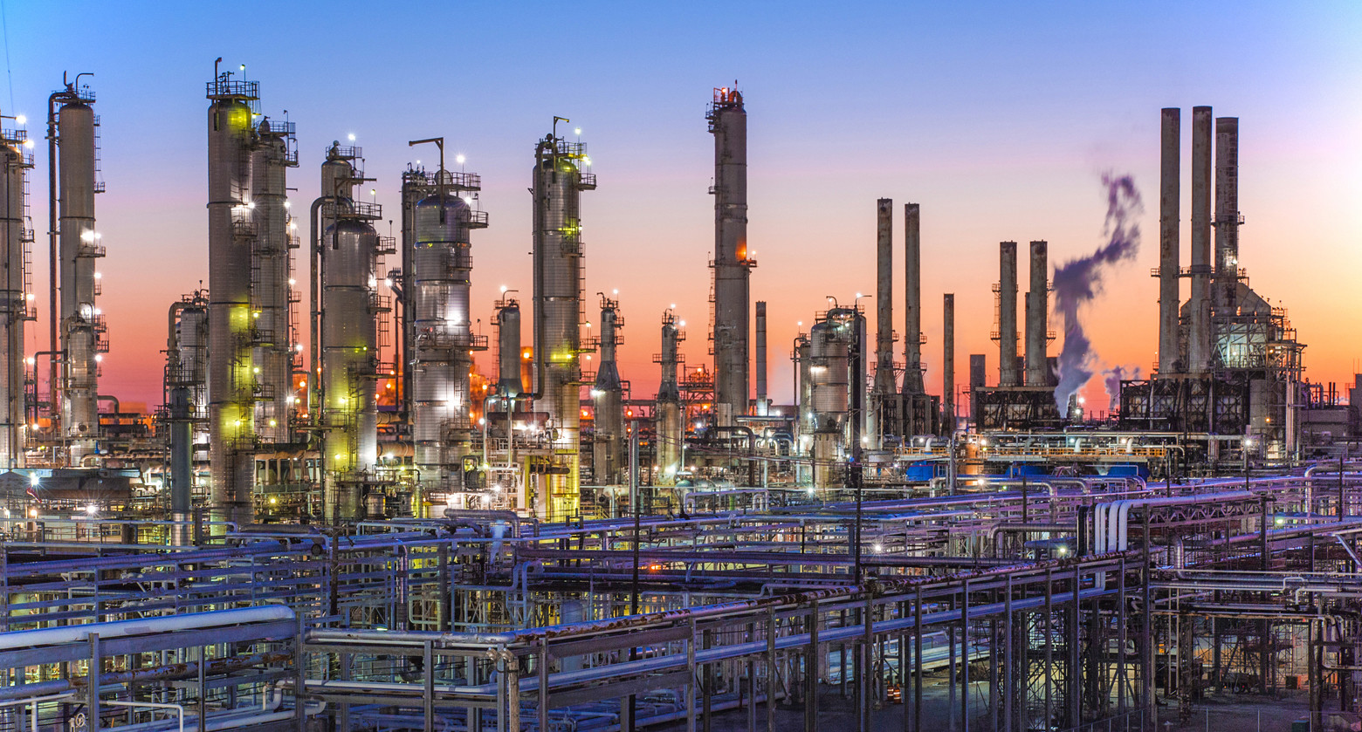
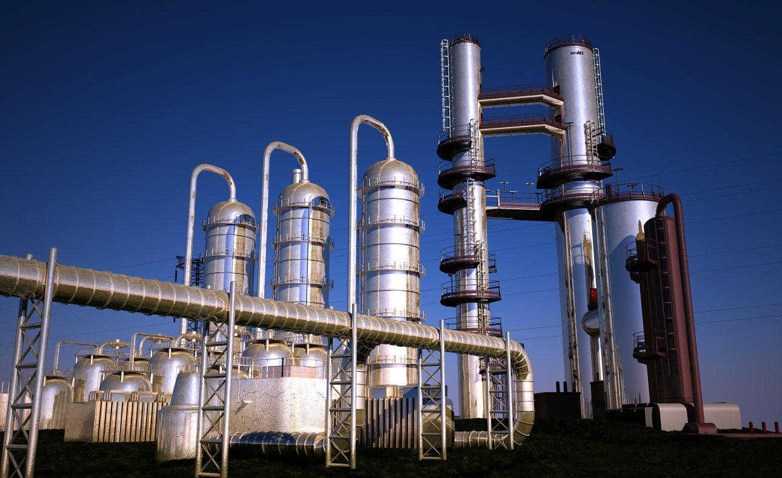
South-East Asia Market Outlook

Slide 16




South-East Asia Copper Sulphate Market Size, By Value
Figure XX: South-East Asia Copper Sulphate Market Size, By Value, 2016-2026F (USD Million)
CAGR (2016-2020)
By Value: 3.39%
CAGR (2021E-2026F)
By Value: 5.89%
Source: ChemAnalyst
Key Influencers
Technological Innovations
Europe & North America Region: Preferred Supplier
Performance of the smaller grain size product
Increasing investments in the oil exploration, building & construction industry and manufacturing sector

Slide 17
South-East Asia Copper Sulphate Market Size, By Volume
Figure XX: South-East Asia Copper Sulphate Market Size, By Volume, 2016-2026F (Kilo Tonnes)
CAGR (2016-2020)
By Volume: 2.74%
CAGR (2021E-2026F)
By Volume: 4.73%
Source: ChemAnalyst

Slide 18
South-East Asia Copper Sulphate Market Share & Size, By Type
Figure XX: South-East Asia Copper Sulphate Market Share, By Type, By Value, 2016-2026F (USD Million)
Source: ChemAnalyst
Table1: South-East Asia Copper Sulphate Market Size, By Value, 2016-2026F (USD Million)
By Type | 2016 | 2017 | 2018 | 2019 | 2020 | 2021E | 2022F | 2023F | 2024F | 2025F | 2026F
Hydrous | 74.25 | 79.00 | 84.49 | 89.69 | 85.14 | 94.74 | 94.75 | 100.25 | 106.22 | 112.69 | 119.61
Anhydrous | 16.41 | 17.37 | 18.56 | 19.54 | 18.44 | 19.24 | 20.27 | 21.33 | 22.45 | 23.70 | 25.04
Source: ChemAnalyst

Slide 19
South-East Asia Copper Sulphate Market Share & Size, By Grade
Figure XX: South-East Asia Copper Sulphate Market Share, By Grade, By Value, 2016-2026F (USD Million)
Source: ChemAnalyst
Table1: South-East Asia Copper Sulphate Market Size, By Value, 2016-2026F (USD Million)
By Grade | 2016 | 2017 | 2018 | 2019 | 2020 | 2021E | 2022F | 2023F | 2024F | 2025F | 2026F
Industrial Grade | 83.73 | 91.17 | 96.70 | 102.27 | 95.68 | 100.63 | 106.71 | 113.01 | 119.80 | 127.05 | 134.99
Reagent Grade | 6.94 | 5.20 | 6.34 | 6.96 | 7.90 | 8.02 | 8.31 | 8.57 | 8.87 | 9.33 | 9.66
Source: ChemAnalyst

Slide 20
South-East Asia Copper Sulphate Market Share & Size, By End Use
Figure XX: South-East Asia Copper Sulphate Market Share, By End Use, By Value, 2016-2026F (USD Million)
Source: ChemAnalyst
Table XX: South-East Asia Copper Sulphate Market Size, By End Use, By Value, 2016-2026F (USD Million)
By End Use | 2016 | 2017 | 2018 | 2019 | 2020 | 2021E | 2022F | 2023F | 2024F | 2025F | 2026F
Agriculture | 38.55 | 41.36 | 43.43 | 46.12 | 43.42 | 45.49 | 47.97 | 50.59 | 53.35 | 56.33 | 59.46
Animal Husbandry | 20.14 | 21.78 | 23.65 | 25.33 | 24.25 | 25.62 | 27.36 | 29.01 | 30.81 | 32.84 | 34.95
Healthcare | 13.84 | 13.98 | 15.46 | 16.56 | 16.08 | 17.29 | 18.41 | 19.60 | 20.85 | 22.40 | 23.91
Industrial | 6.99 | 7.53 | 8.31 | 8.62 | 7.55 | 7.81 | 8.29 | 8.80 | 9.37 | 9.99 | 10.67
Chemicals | 3.66 | 3.67 | 4.17 | 4.33 | 3.78 | 4.04 | 4.31 | 4.53 | 4.69 | 4.91 | 5.17
Leather and Textiles | 2.55 | 2.69 | 2.86 | 2.99 | 2.67 | 2.80 | 2.95 | 3.10 | 3.25 | 3.42 | 3.59
Others | 4.92 | 5.34 | 5.16 | 5.27 | 5.83 | 5.60 | 5.73 | 5.95 | 6.33 | 6.50 | 6.89
Source: ChemAnalyst

Slide 21
South-East Asia Copper Sulphate Market Share & Size, By Country
Figure XX: South-East Asia Copper Sulphate Market Share, By Country, By Value, 2016-2026F (USD Million)
Source: ChemAnalyst
Table XX: South-East Asia Copper Sulphate Market Size, By Country, By Value, 2016-2026F (USD Million)
By Country | 2016 | 2017 | 2018 | 2019 | 2020 | 2021E | 2022F | 2023F | 2024F | 2025F | 2026F
Indonesia | 35.95 | 37.88 | 40.08 | 42.57 | 40.31 | 42.38 | 44.75 | 47.19 | 49.75 | 52.38 | 55.06
Malaysia | 18.73 | 19.99 | 21.39 | 22.58 | 21.84 | 23.01 | 24.26 | 25.59 | 27.04 | 28.63 | 30.24
Vietnam | 18.67 | 20.03 | 21.89 | 23.06 | 21.97 | 22.92 | 24.50 | 26.15 | 28.00 | 30.23 | 32.78
Philippine | 8.13 | 8.55 | 9.00 | 9.53 | 8.79 | 9.33 | 9.86 | 10.40 | 10.96 | 11.54 | 12.17
Thailand | 4.37 | 4.69 | 5.05 | 5.42 | 5.07 | 5.12 | 5.41 | 5.70 | 6.03 | 6.33 | 6.70
Rest of South East Asia | 4.82 | 5.23 | 5.63 | 6.07 | 5.60 | 5.89 | 6.24 | 6.55 | 6.90 | 7.28 | 7.69
Source: ChemAnalyst

Slide 22
South-East Asia Copper Sulphate Market Share, By Company
Figure XX: South-East Asia Copper Sulphate Market Share, By Company, By Value, 2020 (USD Million)
Source: ChemAnalyst
XXXXX
XXXXX
XXXXX
XXXXX
XXXXX

Slide 23
South-East Asia Copper Sulphate Market Map, By Country
Figure 11: South-East Asia Copper Sulphate Market Size (USD Million) & Growth Rate (%), By Country, 2021E-2026F
Market Size @ 17.26 USD Million
Growing Market
(High Growth-Low Market Size)
Overall Market Growth @ 5.81%
Ideal Market
(High Growth-High Market Size)
2021E-2026F
CAGR (2021E-2026F)
Big Market
(Low Growth-High Market Size)
Common Market
(Low Growth-Low Market Size)
Market Size (USD Million)
Source: Secondary Research, Expert Interviews, and ChemAnalyst Analysis
Market size represents 2020 as base year

Slide 24
South-East Asia Copper Sulphate Market Map, By End Use
Figure 11: South-East Asia Copper Sulphate Market Size (USD Million) & Growth Rate (%), By End Use, 2021E-2026F
Market Size @ 14.80 USD Million
Growing Market
(High Growth-Low Market Size)
Overall Market Growth @ 5.49%
Ideal Market
(High Growth-High Market Size)
2021E-2026F
CAGR (2021E-2026F)
Big Market
(Low Growth-High Market Size)
Common Market
(Low Growth-Low Market Size)
Market Size (USD Million)
Source: Secondary Research, Expert Interviews, and ChemAnalyst Analysis
Market size represents 2020 as base year

Slide 25
South-East Asia Copper Sulphate Market Map, By Grade
Figure 11: South-East Asia Copper Sulphate Market Size (USD Million) & Growth Rate (%), By Grade, 2021E-2026F
Market Size @ 51.79 USD Million
Growing Market
(High Growth-Low Market Size)
Overall Market Growth @ 5.84%
Ideal Market
(High Growth-High Market Size)
2021E-2026F
CAGR (2021E-2026F)
Big Market
(Low Growth-High Market Size)
Common Market
(Low Growth-Low Market Size)
Market Size (USD Million)
Source: Secondary Research, Expert Interviews, and ChemAnalyst Analysis
Market size represents 2020 as base year

Slide 26

Indonesia Copper Sulphate Market Outlook

Slide 27
Indonesia Copper Sulphate Market Size, By Volume
Figure XX: Indonesia Copper Sulphate Market Size, By Volume, 2016-2026F (Kilo Tonnes)
CAGR (2016-2020)
By Volume: 2.65%
CAGR (2021E-2026F)
By Volume: 4.86%
Source: ChemAnalyst
Java is estimated to be the dominating region in the Indonesia Copper Sulphate market with a share of 41.80% in 2020, owing to the rapid development in infrastructure coupled with the increasing investments into the agriculture and animal husbandry sector, which have resulted in the expansion of copper sulphate market.
Additionally, rising population, increasing urbanization, growing manufacturing and process industries and rapidly increasing industrial and infrastructural development activities in the region have increased the need for copper sulphate (industrial and reagent).

Slide 28
Indonesia Copper Sulphate Market Share & Size, By Grade
Figure XX: Indonesia Copper Sulphate Market Share, By Grade, By Value, 2016-2026F (USD Million)
Source: ChemAnalyst
Table XX: Indonesia Copper Sulphate Market Size, By Grade, By Value, 2016-2026F (USD Million)
By Grade | 2016 | 2017 | 2018 | 2019 | 2020 | 2021E | 2022F | 2023F | 2024F | 2025F | 2026F
Industrial Grade | 33.48 | 35.85 | 37.67 | 39.92 | 37.09 | 39.36 | 41.66 | 44.05 | 46.55 | 49.13 | 51.77
Reagent Grade | 2.47 | 2.03 | 2.41 | 2.65 | 3.22 | 3.02 | 3.08 | 3.13 | 3.20 | 3.25 | 3.30
Source: ChemAnalyst

Slide 29
Indonesia Copper Sulphate Market Share & Size, By End Use
Figure XX: Indonesia Copper Sulphate Market Share, By End Use, By Value, 2016-2026F (USD Million)
Source: ChemAnalyst
Table XX: Indonesia Copper Sulphate Market Size, By End Use, By Value, 2016-2026F (USD Million)
By End Use | 2016 | 2017 | 2018 | 2019 | 2020 | 2021E | 2022F | 2023F | 2024F | 2025F | 2026F
Agriculture | 18.50 | 19.63 | 20.34 | 21.74 | 20.45 | 21.21 | 22.32 | 23.50 | 24.73 | 26.01 | 27.32
Animal Husbandry | 7.52 | 8.14 | 8.93 | 9.70 | 9.36 | 9.96 | 10.56 | 11.16 | 11.80 | 12.47 | 13.15
Healthcare | 5.21 | 4.56 | 5.28 | 5.84 | 5.57 | 5.95 | 6.36 | 6.80 | 7.24 | 7.87 | 8.38
Industrial | 1.40 | 1.61 | 1.77 | 1.65 | 1.27 | 1.36 | 1.45 | 1.55 | 1.64 | 1.75 | 1.86
Chemicals | 1.26 | 1.17 | 1.37 | 1.29 | 1.17 | 1.25 | 1.34 | 1.37 | 1.32 | 1.32 | 1.35
Leather and Textiles | 0.48 | 0.52 | 0.56 | 0.61 | 0.49 | 0.58 | 0.60 | 0.62 | 0.65 | 0.67 | 0.69
Others | 1.58 | 2.25 | 1.83 | 1.74 | 2.01 | 2.06 | 2.11 | 2.18 | 2.37 | 2.30 | 2.32
Source: ChemAnalyst

Slide 30
Indonesia Supply Outlook
Figure XX: Indonesia Copper Sulphate Import, 2016-2020 (Kilo Tonnes)
Source: ITC Database
Figure XX: Indonesia GDP Growth Rate (%),2015-2020
Table XX: Indonesia Top 5 Importing Countries, By Volume Copper Sulphate, 2020 (Kilo Tonnes)
Countries | Volume (Kilo Tonnes)
Taiwan | 8.60
Thailand | 1.79
China | 1.75
Russia | 0.92
Brazil | 0.61
Source: Economic Statistics on Indonesia
Source: World Bank

Slide 31

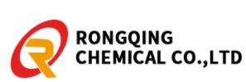
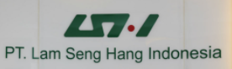

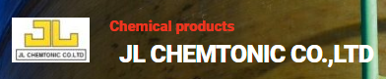
Competition Outlook in Indonesia
Competition Scenario
Leading Companies / Brand in Asia Pacific
Medium
The market is fragmented and there is an emergence of Chinese players who have captured significant share in aftermarket.
Growth Prospects
High
copper sulphate market is expected to rise due to increasing demand for high quality fertilizers, increasing per capita income, rising farming standards, growing population, and extensive R&D for the development of high-quality fertilizers
Outlook
High
Rapid industrialization and urbanization are leading to shrinkage of arable land. Farmers across all geographies are using large quantities of copper sulphate as fertilizers in order to maximize the yield per unit area

Slide 32
Thailand Copper Sulphate Market Outlook

Slide 33
Thailand Copper Sulphate Market Size, By Value & Volume
Figure XX: Thailand Copper Sulphate Market Size, By Value, 2016-2026F (USD Million)
CAGR (2016-2020)
By Value: 3.77%
CAGR (2021E-2026F)
By Value: 5.52%
Source: ChemAnalyst
Thailand copper sulphate market stood at 5.07 USD Million in 2020 and is anticipated to reach 6.70 USD Million at a healthy CAGR of 5.52% in 2026F. The growing demand from agricultural sector in the country stimulated the market for copper sulphate.
Moreover, increasing industrialization and rapid urbanization in the country contributed to the increasing market for the product. The rising electrical industry in the country also boosted the demand of the chemical where it is used an electrolyte in copper plating.

Slide 34
Thailand Copper Sulphate Market Size, By Volume
Figure XX: Thailand Copper Sulphate Market Size, By Volume, 2016-2026F (Kilo Tonnes)
CAGR (2016-2020)
By Volume: 2.51%
CAGR (2021E-2026F)
By Volume: 4.84%
Source: ChemAnalyst

Slide 35
Thailand Copper Sulphate Market Share & Size, By Grade
Figure XX: Thailand Copper Sulphate Market Share, By Grade, By Value, 2016-2026F (USD Million)
Source: ChemAnalyst
Table XX: Thailand Copper Sulphate Market Size, By Grade, By Value, 2016-2026F (USD Million)
By Grade | 2016 | 2017 | 2018 | 2019 | 2020 | 2021E | 2022F | 2023F | 2024F | 2025F | 2026F
Industrial Grade | 3.95 | 4.36 | 4.74 | 4.95 | 4.52 | 4.59 | 4.86 | 5.17 | 5.47 | 5.79 | 6.14
Reagent Grade | 0.42 | 0.33 | 0.31 | 0.47 | 0.54 | 0.54 | 0.55 | 0.53 | 0.56 | 0.54 | 0.56
Source: ChemAnalyst

Slide 36
Thailand Copper Sulphate Market Share & Size, By End Use
Figure XX: Thailand Copper Sulphate Market Share, By End Use, By Volume, 2016-2026F
Source: ChemAnalyst
Table XX: Thailand Copper Sulphate Market Size, By End Use, By Value, 2016-2026F (USD Million)
By End Use | 2016 | 2017 | 2018 | 2019 | 2020 | 2021E | 2022F | 2023F | 2024F | 2025F | 2026F
Agriculture | 1.44 | 1.59 | 1.75 | 1.82 | 1.65 | 1.67 | 1.77 | 1.86 | 1.97 | 2.07 | 2.19
Animal Husbandry | 0.87 | 0.95 | 1.02 | 1.10 | 1.03 | 1.02 | 1.07 | 1.13 | 1.19 | 1.24 | 1.32
Healthcare | 0.65 | 0.70 | 0.75 | 0.81 | 0.81 | 0.82 | 0.87 | 0.92 | 0.97 | 1.02 | 1.08
Industrial | 0.44 | 0.48 | 0.52 | 0.57 | 0.54 | 0.55 | 0.59 | 0.63 | 0.66 | 0.71 | 0.76
Chemicals | 0.27 | 0.29 | 0.32 | 0.35 | 0.29 | 0.31 | 0.33 | 0.35 | 0.37 | 0.39 | 0.41
Leather and Textiles | 0.20 | 0.22 | 0.22 | 0.24 | 0.21 | 0.21 | 0.23 | 0.24 | 0.25 | 0.27 | 0.28
Others | 0.50 | 0.47 | 0.47 | 0.54 | 0.53 | 0.54 | 0.56 | 0.58 | 0.61 | 0.63 | 0.65
Source: ChemAnalyst

Slide 37
Thailand Supply Outlook
Figure XX: Thailand Copper Sulphate Import, 2016-2020 (Kilo Tonnes)
Source: ChemAnalyst
Figure XX: Thailand Agriculture, forestry, and fishing, value added (current US$) Billion, 2015-2020
Table XX: Thailand Top 4 Importing Countries, By Volume Copper Sulphate, 2020 (Kilo Tonnes)
Countries | Volume (Kilo Tonnes)
Taiwan | 1.46
Japan | 0.44
China | 0.13
India | 0.05
Source: World Bank
Source: ITC Data

Slide 38
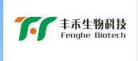
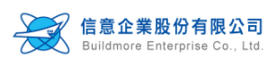

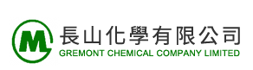
Competition Outlook in Thailand
Competition Scenario
Leading Companies / Brand in Asia Pacific
High
The market is fragmented and there is an emergence of Chinese players who have captured significant share in aftermarket.
Growth Prospects
High
copper sulphate market is expected to rise due to increasing demand for high quality fertilizers, increasing per capita income, rising farming standards, growing population, and extensive R&D for the development of high-quality fertilizers
Outlook
High
Rapid industrialization and urbanization are leading to shrinkage of arable land. Farmers across all geographies are using large quantities of copper sulphate as fertilizers in order to maximize the yield per unit area

Slide 39
Malaysia Copper Sulphate Market Outlook

Slide 40
Malaysia Copper Sulphate Market Size, By Value & Volume
Figure XX: Malaysia Copper Sulphate Market Size, By Value, 2016-2026F (USD Million)
CAGR (2016-2020)
By Value: 3.92%
CAGR (2021E-2026F)
By Value: 5.61%
Malaysia copper sulphate market stood at 21.84 USD Million in 2020 and is anticipated to reach 30.24 USD Million at a healthy CAGR of 5.61% in 2026F. The increasing demand from industrial sector in the country stimulated the market for copper sulphate.
Additionally, the constant demand from the agriculture sector where it is used as a fungicide, pesticide or herbicide contributed to the rising market for copper sulphate in the country. The increasing healthcare sector also boosted the demand for the chemical.
Source: ChemAnalyst
Malaysia Real GDP Growth, 2015-2020 (%)

Slide 41
Malaysia Copper Sulphate Market Size, By Volume
Figure XX: Malaysia Copper Sulphate Market Size, By Volume, 2016-2026F (Kilo Tonnes)
CAGR (2016-2020)
By Volume: 2.95%
CAGR (2021E-2026F)
By Volume: 4.59%
Source: ChemAnalyst

Slide 42
Malaysia Copper Sulphate Market Share & Size, By Grade
Figure XX: Malaysia Copper Sulphate Market Share, By Grade, By Value, 2016-2026F (USD Million)
Source: ChemAnalyst
Table XX: Malaysia Copper Sulphate Market Size, By Grade, By Value, 2016-2026F (USD Million)
By Grade | 2016 | 2017 | 2018 | 2019 | 2020 | 2021E | 2022F | 2023F | 2024F | 2025F | 2026F
Industrial Grade | 17.35 | 19.21 | 20.12 | 21.53 | 20.26 | 21.36 | 22.54 | 23.76 | 25.12 | 26.51 | 27.95
Reagent Grade | 1.38 | 0.77 | 1.27 | 1.05 | 1.58 | 1.65 | 1.73 | 1.83 | 1.92 | 2.12 | 2.29
Source: ChemAnalyst

Slide 43
Malaysia Copper Sulphate Market Share & Size, By End Use
Figure XX: Malaysia Copper Sulphate Market Share, By End Use, By Value, 2016-2026F (USD Million)
Source: ChemAnalyst
Table XX: Malaysia Copper Sulphate Market Size, By End Use, By Value, 2016-2026F (USD Million)
By End Use | 2016 | 2017 | 2018 | 2019 | 2020 | 2021E | 2022F | 2023F | 2024F | 2025F | 2026F
Agriculture | 7.89 | 8.75 | 9.08 | 9.52 | 9.08 | 9.53 | 10.03 | 10.56 | 11.13 | 11.75 | 12.33
Animal Husbandry | 4.29 | 4.59 | 4.92 | 5.20 | 5.05 | 5.39 | 5.75 | 6.10 | 6.50 | 6.99 | 7.44
Healthcare | 2.72 | 2.99 | 3.22 | 3.43 | 3.50 | 3.70 | 3.91 | 4.13 | 4.37 | 4.65 | 4.92
Industrial | 1.78 | 1.81 | 2.05 | 2.17 | 2.09 | 2.23 | 2.36 | 2.50 | 2.65 | 2.81 | 2.98
Chemicals | 0.68 | 0.60 | 0.73 | 0.83 | 0.63 | 0.69 | 0.73 | 0.78 | 0.83 | 0.87 | 0.91
Leather and Textiles | 0.49 | 0.53 | 0.54 | 0.56 | 0.52 | 0.56 | 0.59 | 0.63 | 0.65 | 0.68 | 0.69
Others | 0.88 | 0.71 | 0.86 | 0.86 | 0.97 | 0.91 | 0.89 | 0.89 | 0.91 | 0.88 | 0.97
Source: ChemAnalyst

Slide 44
Malaysia Supply Outlook
Figure XX: Malaysia Copper Sulphate Import, 2016-2020 (Kilo Tonnes)
Source: ChemAnalyst
Figure XX: Malaysia Herbicide Consumption, (Tonnes), 2015- 2019
Table XX: Malaysia Top 5 Importing Countries, By Volume Copper Sulphate, 2020 (Kilo Tonnes)
Sector | Volume (Kilo Tonnes)
Taiwan | 3.91
China | 1.02
USA | 0.58
Russia | 0.18
South Korea | 0.17
Source: FAO Stats
Source: ITC Data

Slide 45
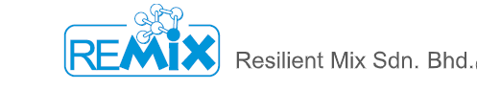

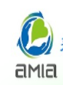
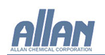
Competition Outlook in Malaysia
Competition Scenario
Leading Companies / Brand in Asia Pacific
High
The market is fragmented and there is an emergence of Chinese as well as American players who have captured significant share in aftermarket
Growth Prospects
High
copper sulphate market is expected to rise due to increasing demand for high quality fertilizers, increasing per capita income, rising farming standards, growing population, and extensive R&D for the development of high-quality fertilizers.
Outlook
High
Rapid industrialization and urbanization are leading to shrinkage of arable land. Farmers across all geographies are using large quantities of copper sulphate as fertilizers in order to maximize the yield per unit area

Slide 46
Vietnam Copper Sulphate Market Outlook

Slide 47
Vietnam Copper Sulphate Market Size, By Value & Volume
Figure XX: Vietnam Copper Sulphate Market Size, By Value, 2016-2026F (USD Million)
CAGR (2016-2020)
By Value: 4.15%
CAGR (2021E-2026F)
By Value: 7.42%
Source: ChemAnalyst
The market of copper sulphate in Vietnam stood at 21.97 USD Million and is expected to reach at 32.78 USD Million growing at a healthy CAGR of 7.42% for the forecasted period.
The increasing industrial sector in the country stimulated the market for copper sulphate where it is used in printing, paint, dyestuffs, and decorative trades. The increasing demand from healthcare sector also contributed to the rising demand of the chemical in the country.
Figure 1: Vietnam Animal Feed Raw Material Consumption, By Value, 2016-20226 (USD Million)
Source: ChemAnalyst

Slide 48
Vietnam Copper Sulphate Market Size, By Volume
Figure XX: Vietnam Copper Sulphate Market Size, By Volume, 2016-2026F (Kilo Tonnes)
CAGR (2016-2020)
By Volume: 3.05%
CAGR (2021E-2026F)
By Volume: 4.70%
Source: ChemAnalyst
Vietnam Number of Animal Farms,2015-2020 (Units)
Source: ChemAnalyst
Vietnam has very limited land capacity and is therefore is not self sufficient in producing agricultural raw materials that are required to process raw materials. As a result, the country is highly dependent on the imports of agriculture feed raw materials such as copper sulphate, soybean meal, corn and wheat.

Slide 49
Vietnam Copper Sulphate Market Share & Size, By Grade
Figure XX: Vietnam Copper Sulphate Market Share, By Grade, By Value, 2016-2026F (USD Million)
Source: ChemAnalyst
Table XX: Vietnam Copper Sulphate Market Size, By Grade, By Value, 2016-2026F (USD Million)
By Grade | 2016 | 2017 | 2018 | 2019 | 2020 | 2021E | 2022F | 2023F | 2024F | 2025F | 2026F
Industrial Grade | 17.19 | 18.99 | 20.75 | 21.50 | 20.56 | 21.31 | 22.85 | 24.41 | 26.20 | 28.27 | 30.79
Reagent Grade | 1.48 | 1.04 | 1.14 | 1.56 | 1.41 | 1.61 | 1.65 | 1.74 | 1.80 | 1.96 | 1.99
Source: ChemAnalyst

Slide 50
Vietnam Copper Sulphate Market Share & Size, By End Use
Figure XX: Vietnam Copper Sulphate Market Share, By End Use, By Value, 2016-2026F (USD Million)
Source: ChemAnalyst
Table XX: Vietnam Copper Sulphate Market Size, By End Use, By Value, 2016-2026F (USD Million)
By End Use | 2016 | 2017 | 2018 | 2019 | 2020 | 2021E | 2022F | 2023F | 2024F | 2025F | 2026F
Agriculture | 6.04 | 6.32 | 6.94 | 7.34 | 7.01 | 7.58 | 8.05 | 8.55 | 9.10 | 9.75 | 10.53
Animal Husbandry | 4.51 | 4.97 | 5.45 | 5.77 | 5.56 | 5.79 | 6.30 | 6.75 | 7.24 | 7.83 | 8.51
Healthcare | 3.17 | 3.48 | 3.84 | 3.92 | 3.79 | 4.20 | 4.50 | 4.81 | 5.16 | 5.57 | 6.05
Industrial | 2.09 | 2.29 | 2.55 | 2.76 | 2.31 | 2.35 | 2.51 | 2.69 | 2.89 | 3.13 | 3.40
Chemicals | 0.79 | 0.89 | 0.98 | 1.04 | 0.95 | 1.01 | 1.08 | 1.16 | 1.24 | 1.35 | 1.46
Leather and Textiles | 0.85 | 0.83 | 0.92 | 0.94 | 0.87 | 0.92 | 0.97 | 1.03 | 1.10 | 1.18 | 1.28
Others | 1.22 | 1.25 | 1.21 | 1.28 | 1.48 | 1.08 | 1.09 | 1.16 | 1.27 | 1.42 | 1.55
Source: ChemAnalyst

Slide 51
Vietnam Supply Outlook
Figure XX: Vietnam Copper Sulphate Import, 2016-2020 (Kilo Tonnes)
Source: ChemAnalyst
Figure XX: Vietnam Agriculture, forestry, and fishing, value added (annual % growth),2015-2020
Table XX: Vietnam Top 5 Importing Countries, By Volume Copper Sulphate, 2020 (Kilo Tonnes)
Countries | Volume ((Kilo Tonnes))
Taiwan | 3.65
Thailand | 2.20
South Korea | 0.98
China | 0.34
Turkey | 0.15
Source: ITC Data
Source: World Bank

Slide 52
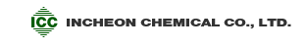
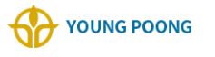
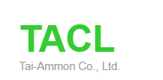
Competition Outlook in Vietnam
Competition Scenario
Leading Companies / Brand in Asia Pacific
Medium
The market is fragmented and there is an emergence of South Korean players who have captured significant share in aftermarket.
Growth Prospects
High
copper sulphate market is expected to rise due to increasing demand for high quality fertilizers, increasing per capita income, rising farming standards, growing population, and extensive R&D for the development of high-quality fertilizers
Outlook
High
Rapid industrialization and urbanization are leading to shrinkage of arable land. Farmers across all geographies are using large quantities of copper sulphate as fertilizers in order to maximize the yield per unit area

Slide 53
Philippines Copper Sulphate Market Outlook

Slide 54
Philippines Copper Sulphate Market Size, By Value & Volume
Figure XX: Philippines Copper Sulphate Market Size, By Value, 2016-2026F (USD Million)
CAGR (2016-2020)
By Value: 1.97%
CAGR (2021E-2026F)
By Value: 5.47%
Philippines copper sulphate market stood at 8.79 USD Million in 2020 and is anticipated to reach 12.17 USD Million which will be growing at a CAGR of 5.47% for the forecasted period.
The rising demand from agricultural sector stimulated the overall copper sulphate market in the country. The increase in spending on personal hygiene and rise in healthcare sector in the country also contributed to the increasing demand of the chemical. The rising animal husbandry market in the country also boosted the demand.
Source: ChemAnalyst

Slide 55
Philippines Copper Sulphate Market Size, By Volume
Figure XX: Philippines Copper Sulphate Market Size, By Volume, 2016-2026F (Kilo Tonnes)
CAGR (2016-2020)
By Volume: 1.85%
CAGR (2021E-2026F)
By Volume: 4.45%
Source: ChemAnalyst

Slide 56
Philippines Copper Sulphate Market Share & Size, By Grade
Figure XX: Philippines Copper Sulphate Market Share, By Grade, By Value, 2016-2026F (USD Million)
Source: ChemAnalyst
Table XX: Philippines Copper Sulphate Market Size, By Grade, By Value, 2016-2026F (USD Million)
By Grade | 2016 | 2017 | 2018 | 2019 | 2020 | 2021E | 2022F | 2023F | 2024F | 2025F | 2026F
Industrial Grade | 7.35 | 7.96 | 8.26 | 8.80 | 8.10 | 8.60 | 9.07 | 9.59 | 10.12 | 10.67 | 11.26
Reagent Grade | 0.78 | 0.59 | 0.74 | 0.73 | 0.69 | 0.73 | 0.79 | 0.80 | 0.84 | 0.88 | 0.92
Source: ChemAnalyst

Slide 57
Philippines Copper Sulphate Market Share & Size, By End Use
Figure XX: Philippines Copper Sulphate Market Share, By End Use, By Value, 2016-2026F (USD Million)
Source: ChemAnalyst
Table XX: Philippines Copper Sulphate Market Size, By End Use, By Value, 2016-2026F (USD Million)
By End Use | 2016 | 2017 | 2018 | 2019 | 2020 | 2021E | 2022F | 2023F | 2024F | 2025F | 2026F
Agriculture | 2.83 | 3.07 | 3.17 | 3.40 | 3.09 | 3.27 | 3.44 | 3.61 | 3.79 | 3.98 | 4.15
Animal Husbandry | 1.79 | 1.88 | 1.99 | 2.10 | 1.93 | 2.05 | 2.17 | 2.29 | 2.42 | 2.54 | 2.69
Healthcare | 1.38 | 1.46 | 1.52 | 1.62 | 1.55 | 1.69 | 1.79 | 1.89 | 2.00 | 2.11 | 2.22
Industrial | 0.95 | 0.98 | 1.04 | 1.05 | 0.96 | 0.90 | 0.95 | 1.00 | 1.04 | 1.09 | 1.14
Chemicals | 0.54 | 0.57 | 0.60 | 0.64 | 0.58 | 0.61 | 0.65 | 0.69 | 0.74 | 0.78 | 0.83
Leather and Textiles | 0.37 | 0.40 | 0.42 | 0.44 | 0.39 | 0.35 | 0.37 | 0.40 | 0.42 | 0.44 | 0.47
Others | 0.27 | 0.17 | 0.27 | 0.27 | 0.28 | 0.46 | 0.49 | 0.52 | 0.55 | 0.60 | 0.67
Source: ChemAnalyst

Slide 58
Philippines Supply Outlook
Figure XX: Philippines Copper Sulphate Import, 2016-2020 (Kilo Tonnes)
Source: ChemAnalyst
Figure XX: Philippines Manufacturing, value added (% of GDP), 2015-2020
Table XX: Philippines Top 5 Importing Countries, By Volume Copper Sulphate, 2020 (Kilo Tonnes)
Countries | Volume (Kilo Tonnes)
Taiwan | 1.62
Russia | 0.80
China | 0.14
Thailand | 0.09
USA | 0.03
Source: ITC Data
Source: World Bank

Slide 59
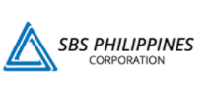
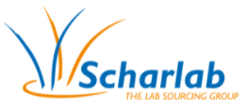


Competition Outlook in Philippines
Competition Scenario
Leading Companies / Brand in Asia Pacific
High
The market is fragmented and there is an emergence of Taiwanese players who have captured significant share in aftermarket.
Growth Prospects
High
copper sulphate market is expected to rise due to increasing demand for high quality fertilizers, increasing per capita income, rising farming standards, growing population, and extensive R&D for the development of high-quality fertilizers
Outlook
High
Rapid industrialization and urbanization are leading to shrinkage of arable land. Farmers across all geographies are using large quantities of copper sulphate as fertilizers in order to maximize the yield per unit area

Slide 60
Rest of South-East Asia Copper Sulphate Market Outlook

Slide 61
Rest of South-East Asia Copper Sulphate Market Size, By Value & Volume
Figure XX: Rest of South-East Asia Copper Sulphate Market Size, By Value, 2016-2026F (USD Million)
CAGR (2016-2020)
By Value: 3.82%
CAGR (2021E-2026F)
By Value: 5.48%
Source: ChemAnalyst

Slide 62
Rest of South-East Asia Copper Sulphate Market Size, By Volume
Figure XX: Rest of South-East Asia Copper Sulphate Market Size, By Volume, 2016-2026F (Kilo Tonnes)
CAGR (2016-2020)
By Volume: 3.11%
CAGR (2021E-2026F)
By Volume: 4.62%
Source: ChemAnalyst

Slide 63
Rest of South-East Asia Supply Outlook
Figure XX: Rest of South-East Asia Copper Sulphate Import, 2016-2020 (Kilo Tonnes)
Source: ChemAnalyst
Table XX: Rest of South-East Asia Top 5 Importing Countries, By Volume Copper Sulphate, 2020 (Kilo Tonnes)
Figure XX: Rest of South-East Asia (Singapore, Lao PDR, Brunei Darussalam, Cambodia) GDP growth (annual %) , 2015-2020
Countries | Volume (Kilo Tonnes)
Taiwan | 0.56
USA | 0.13
China | 0.12
Malaysia | 0.11
Mexico | 0.04
Source: ITC Data
Source: World Bank

Slide 64

Market Dynamics

Slide 65
Drivers
Growing Agriculture Sector
Agriculture accounts for around 10% of South-east Asia’s GDP as of 2020. The governments across the South-east Asian countries such as in Indonesia and others is focusing on increasing agriculture infrastructure (such as irrigation facilities, warehousing and cold storage) to obtain higher yields. This is expected to boost the demand for copper sulphate being used as a fertilizer as it effectively helps in preventing fungus, algae and other unwanted microorganisms as well as helps in improving the quality of soil.
Positive Impact of GST on Fertilizers
Goods Service Tax has impacted the manufacturers of fertilizers in a positive manner. They are entitled to pay 5% of tax whereas before GST, manufacturers were paying 5% of VAT along with 1% of excise duty. With this move, it is anticipated that in the near term, the indigenous fertilizers market would be benefitted. This is expected to further boost the copper sulphate consumption across the South-east Asian countries.
South-East Asia Fertilizer Usage Kg per Hectare of Arable Land, By Country, 2016-2019
2016
2017
2018
2019
Source: Ministry of Agriculture & Farmers Welfare

Slide 66
Drivers
Limited Availability of Arable Land and High Demand for Fertilizers in Emerging Nations
Rising urbanization and industrialization are leading to the shrinkage of available arable land across the South-east Asia. In order to increase the yield and overall productivity, farmers use large quantities of fertilizers that not only prevent unwanted microorganisms but also enhance soil quality. According to the Food and Agriculture Organization (FAO), despite slow population and agriculture sector growth across Indonesia, Thailand and others, food production would continue to grow in the coming years across these countries. As arable farming land is continuously shrinking and it would be very difficult to supply food to the growing population, farmers across all geographies are using large quantities of copper sulphate as fertilizers in order to maximize the yield per unit area.
Farmers in emerging countries across the region are often confronted with issues related to providing optimal nutrients to plants, in a cost-effective manner. Factors driving the copper sulphate market in the emerging markets include increasing demand for high quality fertilizers, increasing per capita income, rising farming standards, growing population, and extensive R&D for the development of high-quality fertilizers. Major emerging countries in the copper sulphate fertilizers market include Indonesia, Thailand, Malaysia, among others. Emerging markets present tremendous untapped growth potential for new as well as existing market players.
South-East Asia Share of Arable Land (% of total land area), 2019 & 2020

Slide 67
Challenges
Threat from Product Substitution/Technology Development
Zinc Sulphate is moving into some markets that is currently occupied by copper sulphate, especially in agricultural applications. Zinc Sulphate is comparatively less toxic than copper sulphate as copper becomes toxic for animals due to skin absorption. Along with and economical protection, cost effectiveness also plays an important role in choosing the right fertilizer. The demand for Zinc Sulphate is anticipated to grow further in end user industries like agricultural and animal husbandry due to its use in animal feeds, agricultural sprays and fertilizers.
Volatility in Raw Material Prices
The prices of copper sulphate are experiencing fluctuations in recent years as it is highly dependent on the price trend of sulphuric acid. Sulphuric Acid is the major raw material used for manufacturing copper sulphate along with copper oxide. This fluctuation is observed recently due to the COVID-19 pandemic across South-east Asia and worldwide impacted the prices of copper sulphate significantly and fertilizer industry as well. Thus, shifts in the feedstock prices affect the gross margin for copper sulphate manufacturers, thereby limiting the growth of this industry in the region.
South-east Asia Sulphuric Acid Pricing Analysis (USD/Tons), 2015-2021E
Source: The World Bank
Source: The World Bank

Slide 68
Market Trends & Developments

Slide 69
Trends & Developments
Escalating Demand for Animal Feed
In order to address the ever-growing demand for food, animal husbandry has observed significant growth in the recent years. This is directly driving the copper sulphate market across South-east Asia which is widely used in animal feed as a basic nutritional supplement to treat copper deficiency in livestock. It is being added in animals’ diet in salt and other animal licks which mainly helps in fattening of pigs and broiler chickens by stimulation the appetite. It is being consumed widely in many countries like Indonesia, Vietnam and others across the South-east Asia as it also offers the lesser requirement of copper ions dosage by nearly 60% and hence significantly reduces the cost as well as poisonous effects associated with copper ions. This will further drive the consumption of copper sulphate in coming years following surge in population and food demand.
Market Penetration
Companies are focusing on expanding their market reach and penetration across various countries across South-east Asia due to strong competition from other players. Further, companies are offering lucrative incentives and schemes to dealers and distributors to boost their product sales. For instance, five percent cash discount is given to dealers on the marked dealer price coupled with several other offers derived for the dealers from region to region. Companies are pushing their products by giving complete solutions to end users, which includes product cost, labor cost, etc., which aids the companies to develop their eco system of products as well as distribution. For example, Buildmore Enterprise Co. Ltd., one of the leading copper sulphate manufacturer, also started the distribution of Cargill's raw materials for food and supplements in 2020.

Slide 70
Trends & Developments
Widespread Adoption of Organic Farming
Organic farming depends on sustainable techniques to enhance soil fertility and crop yield. Organic farming uses crop rotations, crop residues, animal manure, off-farm organic waste, mineral grade rock additives and biological system of nutrient mobilization and plant protection.
As of 2020, the area under organic agriculture across the Asia was about 6.2 million hectares with Philippines holding the largest share of nearly 72%, followed by Vietnam and Thailand with higher anticipated growth across these countries in forthcoming years. Additionally, the Institute for Sustainable Agricultural Communities (ISAC) of Thailand encourages organic farming in the country which is expected to reach 208,000 hectares by 2022.
Consequently, growing interest in organic farming, which utilizes organic nutrients to ensure high yields and maintain soil health, also consumes copper sulphate as an essential fungicide backed by its ability to kill fungi, algae and other pests via their membrane disruption. All these factors are expected to support the growth of copper sulphate across different farming techniques and methods in the region.
Agricultural Land Under Organic Farming, By Country, Hectares
Source: Research Institute of Organic Agriculture (FiBL)

Slide 71

Customer Analysis

Slide 72
Copper Sulphate Customer Analysis
S.No. | Company | Plant Location & Country | End-Use | Copper Sulphate Consumption in 2020 | Price (2020) USD / Kg | Supplier Details | Contact Details | Product Specifications
 |  |  |  | (Tonnes)
1. | Pt Japfa Comfeed Indonesia Tbk | Tebet, Indonesia | Animal Husbandry | 226.8 | 2.18 | Annona Pte Ltd | Ambang Budi Hendarto Chief Operating Officer, Operation 1 - Poultry Indonesia Contact:021-2854 5680 (Hunting) | Reagent Grade
2. | Pt Dian Cipta Perkasa | Melayu, makasar, jaktim, Indonesia | Trader | 216 | 1.85 | Asian Chemical Co.,Ltd | Mr. Rudi Ismanto (Chief Executive Offier) Contact:+62 21 8660 7760 / 62 | Reagent Grade
3. | Pt. Agrofarm Nusa Raya | Kertosari Babadan, Ponorog, Indonesia | Trader | 619 | 2.11 | Mega Agro Sejahtera Sdn Bhd | Agus Yahya Director Of Operations Contact :+62 352 3591094 | Reagent Grade
4. | Charoen Pokphand Indonesia | Jl. Ancol VIII/1 Jakarta Indonesia | Trader | 120 | 2.212 | Max Chemicals Co.,Ltd | Jl. Ancol VIII/1 Jakarta 14430 Indonesia Contact : 62-21-6919999 | Reagent Grade
5. | Charoen Pokphand Indonesia | Jl. Ancol VIII/1 Jakarta, Indonesia | Trader | 27 | 2.16 | H And T Corporation Limited | Jl. Ancol VIII/1 Jakarta 14430 Indonesia Contact : 62-21-6919999 | Reagent Grade

Slide 73
Copper Sulphate Customer Analysis
S.No. | Company | Plant Location & Country | End-Use | Copper Sulphate Consumption in 2020 | Price (2020) USD / Kg | Supplier Details | Contact Details | Product Specifications
 |  |  |  | (Tonnes)
6. | Pt.Mest Indonesia | Jl Kh Masyur No.121,kare, Indonesia | Trader | 192 | 1.5 | Gremont Chemical Company Limited | Sandy Okta Piansyah Marketing Executive Contact:+62 61-80032168 | Reagent Grade
7. | Pt. Agrofarm Nusa Raya | Babadan, Ponorog, Indonesia | Trader | 96 | 2.3 | Gremont Chemical Company Limited | Agus Yahya Director of Operations Contact: +62 352 3591094 | Reagent Grade
8. | Pt. Agri Indomas | karet Tengs, Indonesia | Trader | 50 | 1.79 | Crown Champion International Pte Ltd | Hendra Lubis, Assisttant Manager, Contact: 711 721111 | Reagent Grade
9. | Pt. Santani Sejahtera | Kota Me, Indonesia | Trader | 20 | 1.80 | Chemtronic Technology (Thailand) Co., Lt | Jefry Efendy Sales Manager Contact:(061) 4573028 | Reagent Grade
10. | Pt Seribu Cita Bayanaka | Citra Raya Blok S.06/368, Indonesia | Trader | 24 | 2.08 | Max Chemicals Co., Ltd | Fauzan Latief Commercial Director | Industrial Grade

Slide 74
Copper Sulphate Customer Analysis
S.No. | Company | Plant Location & Country | End-Use | Copper Sulphate Consumption in 2020 | Price (2020) USD / Kg | Supplier Details | Contact Details | Product Specifications
 |  |  |  | (Tonnes)
11. | Pt Jade Wijaya Mandiri | Tangerang 1, Indonesia | Trader | 2 | 3.59 | Yee Lee Industrial Chemical Ltd | Irwansjah Rusli Sales Manager Telp : +6221 29238873 | Industrial Grade
12. | Ruby Company Limited | Quận Phú Nhuận, , Vietnam | Trader | 240 | 2.27 | Asian Chemical Co.,Ltd | Xx | Reagent Grade
13. | Dsm Nutritional Products Vietnam Ltd. | Tỉnh Bình Dương, Vietnam | Healthcare | 72 | 1.94 | Asian Chemical Co.,Ltd | Xx | Reagent Grade
14. | Emivest Feedmill (Tg) Viet Nam Co., Ltd | T.Tien Giang, Vietnam | Animal Husbandry | 24 | 2.2 | Fine Top International Co., Ltd, | Garfiled Heng Purchasing Manager Contact:(84-273) 3620 333 | Reagent Grade
15. | An Phu Company Limited | Quận Đống Đa, Tp.Hà Nội, Vietnam | Trader | 21.77 | 2.33 | Fine Top International Co., Ltd | David Nguyen Sales Manager Contact:+84985228133 | Industrial Grade

Slide 75
Copper Sulphate Customer Analysis
S.No. | Company | Plant Location & Country | End-Use | Copper Sulphate Consumption in 2020 | Price (2020) USD / Kg | Supplier Details | Contact Details | Product Specifications
 |  |  |  | (Tonnes)
16. | Biomin Việtnam Co.,Ltd | Thành Phố Hà Nội, Việtnam | Animal Husbandry | 24 | 2.28 | Asian Chemical Co., Tld | Phuong Nguyen Quang Managing Director Contact:+84 650 222 1288 | Reagent Grade
17. | Cargill Vietnam Company Limited | Tỉnh Đồng Nai, Việtnam. | Animal Husbandry | 18 | 2.00 | Asian Chemical Co.,Ltd | Le Hoang Minh Regional Operation Manager Production & Maintenance Contact: + 84-28-5416 1515 | Reagent Grade
18. | Alsons Aquaculture Corp. | Makati City Makati, Philippines | Agriculture |  | 2.14 | Team Aqua Corporation | Jhoer Geronaga Manager Contact:+63 83 508 2300 | Reagent Grade
19. | Bestelement Industrial Ltd Inc. | Pampanga, Philippines | Trader | Xx | 2.30 | Jaw Lien Enterprise Co Ltd | Karen Manarang Assistant Accounting Officer Contact:+63 905 241 6698 | Industrial Grade
20. | Cebu Far Eastern Drug Inc | Location 9 | Trader | Xx | 2.15 | Scharlab S. L. | Margaret U. Chang, Treasurer, Contact: (032) 2558741-3 ; (032) 4234279 | Reagent Grade

Slide 76
Copper Sulphate Customer Analysis
S. No. | Company | Plant Location & Country | End-Use | Copper Sulphate Consumption in 2020 | Price (2020) USD / Kg | Supplier Details | Contact Details | Product Specifications
 |  |  |  | (Tonnes)
21. | Cleveland Industries Inc. | Malabon City, Philippines | Trader | Xx | 2.22 | Tai-ammon Co., Ltd | Xx | Industrial Grade
22. | Fcf Minerals Corp. | Makati City, Philippines | Industrial |  | 2.01 | Buildmore Enterprise Co., Ltd | Lugrine Comtiag Process Plant Operations Superintendent Contact:+63 (0) 2 659 5662 | Industrial Grade
23. | Agricultural Chemicals (M) Sdn. Bhd. (Acm) | Pulau Pinang, Malaysia | Agriculture | Xx | Xx | Xx | Nurul Nabila Executive Contact:+604-390 7988 | Reagent Grade
24. | Biovista Lifesciences Sdn Bhd | Kuala Lumpur, Malaysia | Agriculture | Xx | Xx | Xx | Nor Syafiqah Abd Rashid Product Development Executive Contact:+603 9102 3886 | Reagent Grade
25. | Hextar Group | Selangor ,Malaysia | Agriculture | Xx | Xx | Xx |  | Reagent Grade

Slide 77
Copper Sulphate Customer Analysis
S.No. | Company | Plant Location & Country | End-Use | Copper Sulphate Consumption in 2020 | Price (2020) USD / Kg | Supplier Details | Contact Details | Product Specifications
 |  |  |  | (Tonnes)
26. | Nufarm | Shah Alam, Malaysia | Agriculture | Xx | Xx | Xx | Jackie Boo Chen Long Marketing Executive Contact : +6017 6677 345 | Reagent Grade
27. | Felcra Plantation Services Sdn Bhd | Kuala Lumpur, Malaysia | Agriculture | Xx | Xx | Xx | Noor Wahida Sulaiman Finance Manager Contact :+6034 1455 000 | Reagent Grade

Slide 78

Additional Customization

Slide 79
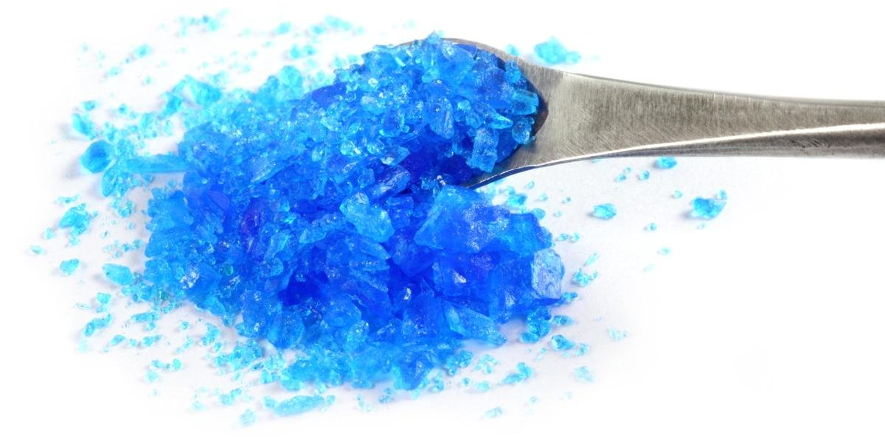
Global Copper Sulphate Manufacturing Process Overview
Copper sulphate
Copper Sulphate pentahydrate (Feed grade 25%)
Specifications
Copper sulphate is a blue colored inorganic salt of copper that most commonly occurs in its pentahydrate form i.e., Cu₂SO₄.5H₂O. It is commercially known as blue vitriol or chalcantihite. Applications of copper sulphate touches a wide range of sectors where it is used as: a fungicide for protection of agricultural plants, a mordant for dying vegetables, a reagent to produce rayon, a germicide in leather industry, a laboratory reagent, an electrolyte for copper refining, an anti-fouling agent in paints etc.
Parameter/Property | Result
Copper (Cu) | 25%
Purity (Cu₂SO₄.5H₂O) | 98%
Iron (Fe) | 100 ppm
Lead (Pb) | 20 ppm
Nickel (Ni) | 20 ppm
Cadmium (Cd) | ND (< 0.5 ppm)
Arsenic (Ar) | ND (< 5 ppm)
Mercury (Hg) | ND (< 5 ppm)
Appearance | Free flowing blue crystal

Slide 80
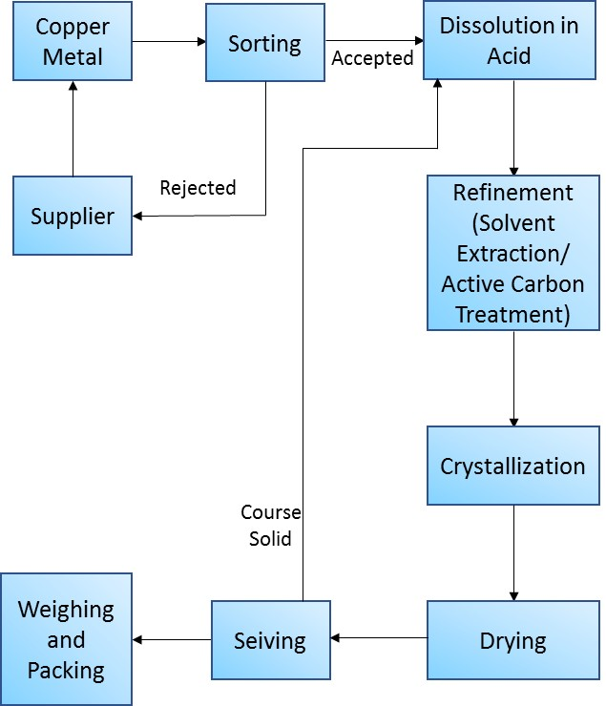
Global Copper Sulphate Manufacturing Process Overview
PROCESS DETAILS
Reaction of Copper scrap with sulphuric acid
The most common industrial method for the production of copper sulphate involves the heating of copper scrap with dilute sulphuric acid to form a saturated solution which is allowed to undergo gradual cooling under the influence of cooling vats to get the crystalline form of copper sulphate. In order to obtain the granulated crystal grades of copper sulphate, the cooling process is accelerated through agitation of the reaction mixture in the cooled vessels. Metallic copper scrap is generated in copious amounts from the ore refinement techniques, making it the most abundant source for copper sulphate generation. Active carbon treatment is often to the acidic solution of copper scrap in in order to obtain highly pure (> 98%) copper sulphate inorganic salts.
Process Flowchart

Slide 81
Global Copper Sulphate Manufacturing Process Overview
Reaction of copper scrap with sulphur
An indirect method of synthesizing copper sulphate involves heating of copper scrap with sulphur to form copper sulphide followed by its oxidation to generate copper sulphate.
Ammonia leaching process
Slow leaching of malachite ore using saturated ammonia is performed under heating conditions to obtain cupric ammine complex. This complex is treated with dilute sulphuric acid which results into the formation of copper sulphate. complete process involves the steps of ore leaching, solvent extraction (for the removal of intermediates and impurities) and crystallization.
Electrochemical oxidation of metallic copper
The electrochemical oxidation of metallic copper in sulphuric acid is also an efficient method to produce copper sulphate. Copper wires are used as anode and cathode in an electrochemical cell containing dilute sulphuric acid. On applying the electrical potential to the system, copper from the anode side oxidises to its (+2) oxidation state and goes into the sulphuric acid solution, eventually reacting with it to form copper sulphate that gives blue color to the solution. The blue colored acidic solution is boiled and allowed to cool slowly for precipitating out the copper sulphate powder. This method is very efficient in producing copper sulphate in high yields. Furthermore, this process is advantageous in the recycling of copper wire as waste copper wires are used as electrodes for the electrochemical generation of Cu²⁺ ions that react sulphate ions to produce copper sulphate.

Slide 82
Global Copper Sulphate Manufacturing Process Overview
TECHNOLOGICAL MATURITIES
Technology | Status
Reaction of copper scrap with sulphuric acid | Widely used Commercial method
Reaction of copper scrap with sulphur | Widely used Commercial method
Ammonia leaching process | Patented method (Pilot Scale)
Electrochemical oxidation of metallic copper | Pilot Scale method

Slide 83
Global Copper Sulphate Manufacturing Process Overview

Slide 84
Copper Sulphate Margin Analysis, 2016-2030F
Figure XX: Copper Sulphate Margin Analysis, 2016-2030F
The profit margins generally ranges from 10-15% of the actual selling price of the copper sulphate. The profit margin varies with the amount of order quantity generally increases with the increase in the quantity ordered. The margin varies depending on the type of purity level and the specification of copper sulphate.
10-15%
15-20%
The variable cost generally varies from 15-20%. Distributor plays an important role in copper sulphate value chain due to presence of large number of unorganized copper sulphate players in industry. The variable cost generally works on the principle of economies of scale. With higher operating rate, cost associated with it reduces per unit and thus the likelihoods to earn more margin increases. This costs generally include the machinery operability cost ,electricity, etc.
65-70%
The raw material costs may vary from grade to grade and complexity of system insulation. The raw material cost generally lies around 65-70%. Raw Material costs includes the costs of raw material, labelling, manpower etc.
Source: ChemAnalyst .
The increasing demand of copper sulphate from agricultural and animal husbandry industry as a fungicide, herbicide or pesticide drives the overall Southeast Asia market. The profit margin varies in different countries due to availability of raw material, demand from the end – user industries, presence of coal mines as copper is produced from mining operations, therefore Indonesia and Malaysia are the two major countries where higher profit margins occurs.

Slide 85

COMPETITIVE LANDSCAPE

Slide 86
Product Benchmarking, By Supplier
Company Name | Industrial Grade | Reagent Grade
Pt. Lam Seng Hang Indonesia | Yes | Yes
Chemtronic Technology (Thailand) Co Ltd | No | Yes
Buildmore Enterprise Co., Ltd, | Yes | Yes
Fajar Zippindo Pt | Yes | Yes
Resilient Mix Sdn. Bhd | Yes | Yes

Slide 87
Product Benchmarking, By Grade
Grade Name | Pt. Lam Seng Hang Indonesia | Chemtronic Technology (Thailand) Co Ltd | Buildmore Enterprise Co., Ltd, | Fajar Zippindo Pt | Resilient Mix Sdn. Bhd
Industrial (25%) | No | Yes | Yes | No | No
Feed Grade(23%) | No | No | Yes | No | No
Feed Grade(24.5%) | No | No | Yes | Yes | No

Slide 88

Lam Seng Hang Indonesia. PT
Business Overview:
The company was established in 2000 and is a leading manufacturer of copper sulphate and is specialized in the supply of various industrial and specialty chemicals to different industries in Indonesia.
The company has its headquarters in Singapore.
The company has been serving chemicals for more than 50 years and has presence of around 15 years in Indonesia.
The company possesses a strong research & development strength with technical research & development center at municipal level.
The company provides its products in different segments, i.e., for industry, for food, for chemical functions, for pharmacy and essential oils.
The company expanded its business fields to food and pharmaceuticals industries in 2012.
The company also expanded its business scope to tire division in 2014.
In the 1990s, the company also expanded its business in various other countries in South-east Asia.
It provides different chemicals for different end user industries like paint, coating & ink, textile, adhesive, water treatment, oil & gas, metal treatment and feed.
Key Products:
Copper Sulphate Pentahydrate
Benzoic Acid
Ipa Isopropyl Alcohol
Fumaric Acid
Pbtc
Choline Chloride 60% Corn Cob
KEY MANAGEMENT PERSONNEL
Mr. Yue Huan Lee (Chairman & CEO)
COMPANY CONTACT ADDRESS
Cyber 2, Tower, Blok X5 No. 13, 12950 RT.7/RW.2 Kuningan Timur Kota Jakarta Selatan DKI Jakarta ID 12950, Jl. H. R. Rasuna Said, RT.1/RW.2, Kuningan, Kuningan Tim., Kecamatan Setiabudi, Kota Jakarta Selatan, Daerah Khusus Ibukota Jakarta 12950, Indonesia
Contact No: +62 21 29021438
Source: http://lsh-indonesia.com/

Slide 89
Chemtronic Technology
(Thailand) Co.,Ltd.
Business Overview:
The company was established in 2006 at Rojana Industrial Park, located in Ayutthaya Province, Thailand.
It is one of the leading manufacturers in copper sulphate with annual capacity of 6000 tonnes.
The company focuses on product development, production and service, quality, safety and customer satisfaction.
The company’s mission is to provide the product copper sulphate with international quality standards and competitive prices.
It produces copper sulphate pentahydrate which has its applications in fertilizers in plantation, animal feed additive, wood fungicides, soil improvement, fishery and shrimp goods.
It is certified with ISO 9001 : 2015, CODEX : GMP, and FAMI - QS.
KCE Electronics Public Company Limited acquired Chemtronic Technology Co. Ltd. on October 2, 2012, which holds around 94.75% of shares.
It provides copper sulphate with certain specifications like purity with greater than 98%, and lead with maximum 50 ppm.
Key Products:
Copper Sulphate Pentahydrate
KEY MANAGEMENT PERSONNEL
Mr. Anastasios Papadopoulos (Chairman & CEO)
COMPANY CONTACT ADDRESS
28 1 Khan Ham, Uthai District, Phra Nakhon Si Ayutthaya 13210, Thailand
Contact No: +66 35 719 674
Source: http://www.chemtronic-thai.com/

Slide 90
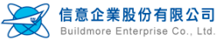
Buildmore Enterprise Co., Ltd
Business Overview:
The company was established in August 1984 and has its headquarters in Taipei, Taiwan.
The company is specialized in tariff barriers and in import/export.
The company provides complete business solution to chemical manufacturers in Taiwan from importing chemical raw material form suppliers.
The company has two divisions – Chemical and Food.
In 2002, the company established the food department with GELITA in extending the use of gelatin products into foods, drugs and supplements.
The company also began the distribution of Cargill’s raw materials for food and supplements which provides quality raw materials to foreign suppliers.
The company produces various chemicals like Aluminium Sulphate, Antimony Trioxide, Cobalt Oxide, Copper Sulphate Pentahydrate, Zinc Sulphate Heptahydrate, etc.
It provides different chemicals for different end user industries like agriculture, livestock and poultry feed, water treatment, sewer treatment, chemicals, pigments, metals, wood preservative, mining, fertilizer, etc.
The food division has different product lines, i.e., food ingredient, food additive, functional raw materials, etc.
Key Products:
Copper Sulphate Pentahydrate
Aluminium Sulphate
Calcium Phosphate
Ferric Chloride, Solution
Zinc Sulphate Monohydrate
Gelatine
Konjac Gum
Isomalt
Collagen Hydrolysate
KEY MANAGEMENT PERSONNEL
Mr. Yue Huan Lee (Chairman & CEO)
COMPANY CONTACT ADDRESS
7F-2, No. 57, Fu-Hsing N. Rd., Taipei, Taiwan, R.O.C.
Contact No: +886 -2- 2752－3137
Source: http://www.bm-group.tw/

Slide 91

Fajar Zippindo. PT
Business Overview:
Fajar Zippindo. PT was established in 1995 and has its headquarters in Tangerang, Indonesia.
The company specializes in the manufacturing of Copper Sulphate.
The company is currently having the annual production capacity of 1800 tons per year.
It provides copper sulphate with purity of 97 +/- 0.5%.
It produces copper sulphate in two major grades – Industrial and feed.
The company provides the product in two forms- powder and crystalline.
It produces copper sulphate for different applications like animal feed, fungicide, algicide, electroplating herbicide, as fertilizer and in industrial manufacturing.
The company provides copper sulphate with specifications like Fe – 50 ppm, Pb – 30 ppm, As – 5 ppm, Cd – 5 ppm, Hg – 5 ppm, Cr – 5 ppm and Cu – 24.5% min purity.
The packing details of the product include 25 Kg/Bag or 1 MT/ Jumbo Bag.
The company is committed to provide its customers with quality product and good partnership.
No.of employees as of 31 March 2021 are 40
Key Products:
Copper Sulphate Pentahydrate
KEY MANAGEMENT PERSONNEL
Ms. Ruri Ruri (Key Account Personnel)
COMPANY CONTACT ADDRESS
Jl. Daan Mogot Km 19/22, Jurumudi Baru Benda, Batu Ceper, Jakarta, 15122, RT.7/RW.3, Kalideres, West Jakarta City, Jakarta 11840, Indonesia
Contact No: +62 21 5407234
Source: https://www.zippindo88.com/

Slide 92
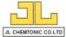
JL Chemtonic Co., Ltd.
Business Overview:
JL Chemtonic Co., Ltd. was established in the year 2005 and has its headquarters in Thailand.
The company is the largest manufacturer of Copper Sulphate Pentahydrate, Ferric Chloride, Ferrous Chloride, Poly Ammonium Chloride Liquid in Thailand.
It is also the major supplier of Chlorine, Sulfuric Acid (98%, 70%, 50%, 35%), Hydrochloric Acid (18%, 35%), Caustic Soda Solution (32% and 50%) and other chemicals.
The products produced by the company are used in many different end user industries, including dairy farming, animal feed, water treatment as an aquatic algaecide, food and pharmaceutical processing and pool chemicals.
The products produced by the company are used in various applications in different industries like plating and metal industry, auto parts industry, electronic industry, food and beverage industry, paper industry and many more.
The supply ability of copper sulphate by the company is 1500 Tons/per month.
The company provides the products in 25 kg, 50 kg, or 1 MT net in PP woven bag with PE bag inner.
Key Products:
Copper Sulphate Pentahydrate
Ferric Chloride
Poly Aluminium Chloride
Ferrous Sulphate
Ferrous Chloride
KEY MANAGEMENT PERSONNEL
COMPANY CONTACT ADDRESS
9/9 Moo 1 Chaimongkhon Dist Rd. Tumbol Chaimongkhon, Amphoe Mueang Samut Sakhon, Samut Sakhon 74000, Thailand
Contact No: 0-3488-1246-7
Source: http://www.jlchemtonic.com/

Slide 93

Resilient Mix Sdn. Bhd. (REMIX)
Business Overview:
Resilient Mix Sdn. Bhd. (REMIX) was established in 2005.
The company is in Juru Industrial Park, Penang, West Malaysia.
It has a full facility to produce copper sulphate from pure copper metal.
The company usually produces two grades of Copper sulphate- feed and industrial grade.
According to different grades produced, the product is used in various applications such as mineral additive, wood preservative, agriculture, electroplating and as a catalyst in chemical industry.
The company is capable of producing 5000 tons per annum of copper sulphate.
The copper sulphate produced by the company has excellent quality which provides free flowing crystal powder extended shelf life and full dryness which allows its usage as a dietary supplement in animal feed and poultry farm industries.
It provides the product in 25 kg UN approved bags on shrink wrapped pallets of 1 ton.
It provides copper sulphate with 98% purity with Iron content 100 ppm, Lead 20 ppm, and Nickel 20 ppm.
The company possess full facility to produce, reprocess, and distribute all grades of copper sulphate.
Key Products:
Copper Sulphate Pentahydrate
KEY MANAGEMENT PERSONNEL
COMPANY CONTACT ADDRESS
81 & 83, Jalan Industri Beringin,
Taman Perindustrian Beringin, 14000 Juru,
S.P.T., Penang, Malaysia
Contact No: +604 5024 282
Source: https://www.remixsb.com

Slide 94

Strategic Recommendations

Slide 95

Emphasize on Feed Grade
The demand for Feed Grade copper sulphate, consumed in high volume in animal husbandry, is anticipated to expand at a highest CAGR of 6.08% during the forecast period. Whereas, the major demand comes from the agricultural sector across South-east Asia which is estimated to hold nearly 42% share in value terms, as of 2020. This dominance is attributed to high consumption of copper sulphate being employed in the fungicide, herbicides, fertilizers, etc. to protect crops against mold, algae, bacteria, etc. Additionally, it provides essential nutrients to plants.
Substantial use of copper sulphate in animal husbandry owing to its antimicrobial properties and its ability to help in promoting growth and treat copper deficiencies in animals. The region is experiencing a huge demand for meat mainly poultry and pork, which is further anticipated to increase manifold in the coming years.
Thus, sulphur fertilizer companies are recommended to focus on the production of feed grade copper sulphate during the forthcoming years in order to maintain strong presence in the market.

Slide 96
Target Country – Indonesia
Indonesia dominated the South-east Asian copper sulphate market with a share of 41.72%, in volume terms, in 2020. High availability of arable land in the country has made it one of the leading crop producers and food exporters in the region, thereby generating huge demand for fertilizers, fungicides, etc. in the country to ensure maximum yield. Despite having a smaller workforce, the agricultural sector in Indonesia holds significant share across the region.
Currently, Indonesia is importing large volume of copper sulphate following the growing demand and have easy access to the exporting countries like China and Japan. Also, shifting preference for customized diets and eating patterns have generated demand for protein meals in the country. A significant growth in the per capita meat consumption across Indonesia has been witnessed in the past few years following increase in income across the country. This generates the demand for copper sulphate used widely across animal feed to fortify food as well as prevent mold growth. These factors have resulted in increased demand for copper sulphate in the country backed by surging animal husbandry across the country. Hence, sulphur fertilizer companies are recommended to increase their focus on Indonesia in order to tap the emerging opportunities in the market.

